Slide 1
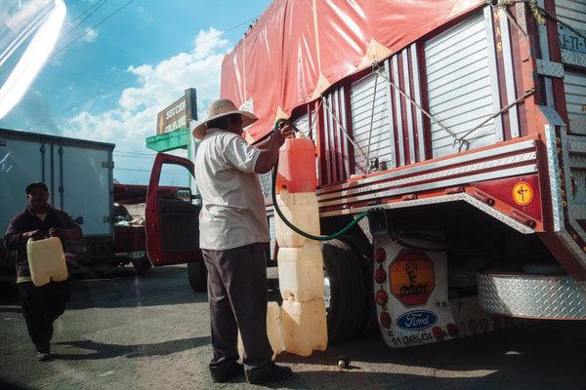
Stealing Petrol in Mexico

Slide 2
Resources
https://www.nytimes.com/2019/01/11/world/americas/mexico-gas-crisis.html
https://www.youtube.com/watch?v=AO0bohjwMgE

Slide 3
Background
The theft of fuel (petrol and diesel) has become a real issue in Mexico. Illegal taps on fuel pipelines has meant a loss in supply but also the death of people in explosions. Mexico’s drug cartels have also moved into fuel theft, lured by high prices. The cartels terrorize Pemex (state run Mexico oil refining company) workers with the choice of “plata or plomo” – silver or lead. The theft of fuel in Mexico is robbing the Government of more than a billion dollars a year in revenue.

Slide 4
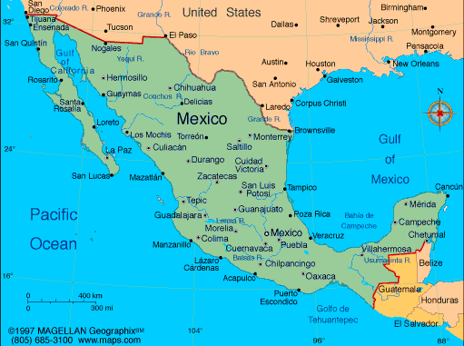
Describe the geographic location of Mexico

Slide 5
Illegal Fuel Pipe Taps - Guanajuato
YEAR | NUMBER OF ILLEGAL FUEL PIPE TAPS
2012 | 25
2014 | 27
2015 | 50
2017 | 145
2018 | 1852
1. Use an appropriate statistical method to represent this data.
2. Describe the temporal pattern of the graph.

Slide 6
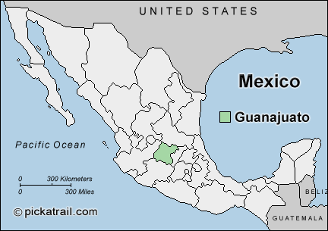
Describe the location of Guanajuato.

Slide 7
Impacts of Fuel Thefts
Read this article:
https://www.nytimes.com/2017/04/26/world/americas/mexico-fuel-theft-crisis.html
1. What is the impact on people from the fuel thefts?
2. How is the fuel being stolen?
3. What volume of fuel is being stolen now compared to 2009?

Slide 8
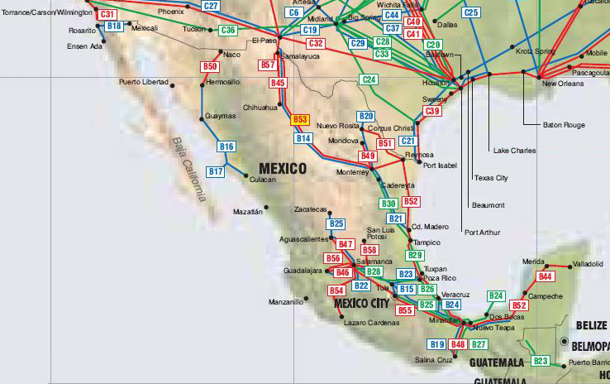
Describe the spatial pattern of Mexico’s fuel pipelines.
Hint: Describe where locations where the pipes are and where they are not

Slide 9
Fuel Loss – NZ Examples
https://www.stuff.co.nz/business/106361441/daily-petrol-thefts-cause-christchurch-station-owners-to-take-elaborate-measures
Read the above article.
Why are people stealing petrol?
What are petrol stations doing to ensure customers pay for petrol?
https://www.nbr.co.nz/article/refining-nz-could-lose-15m-after-fuel-pipeline-breach-ns-207792
What were the economic impacts of the fuel pipeline damage in Northland in 2017?

Slide 10
Percentage Bar Graph
In Mexico 1,470,000 gallons of fuel are stolen per day from pipelines and oil refineries. This is from a total fuel consumption of 33,180,000 gallons of fuel per day.
Calculate the percentage of fuel stolen per day.
Represent this data on a percentage bar graph.
Write a generalisation of what your graph illustrates.

Slide 11
Geographic Concept
Explain how stealing fuel in Mexico impacts on the Mexican economy AND people.
In your answer, refer to:
• the geographic concept of Perception
• specific information and examples from your earlier answers and resources

